Slide 1
Digital Portfolio
STUDENT NAME:R.SASI KUMAR
REGISTER NO AND NMID: 60C06AA2170B5EDA62D4D19515C80808
DEPARTMENT: BCA
COLLEGE: NAZARETH COLLEGE OF ARTS AND SCIENCE

Slide 2


AGENDA
Problem Statement
Project Overview
End Users
Tools and Technologies
Portfolio design and Layout
Features and Functionality
Results and Screenshots
Conclusion
Github Link
3/21/2024 Annual Review

Slide 3

PROBLEM STATEMENT
To create a personal digital portfolio website showcasing my skills, projects, and contact information.

Slide 4
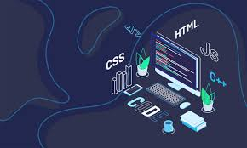
PROJECT TITLE
Personal Digital Portfolio using HTML, CSS, and JavaScript

Slide 5

PROJECT OVERVIEW
Developed a simple portfolio website using HTML, CSS, and JavaScript.
Includes About, Skills, and Contact sections.
Interactive contact form with success message feature.

Slide 6

WHO ARE THE END USERS?
Students: To showcase their academic projects and achievements.
Job Seekers: To present skills and work experience in a creative way.
Freelancers: To share portfolio and attract clients.

Slide 7

TOOLS AND TECHNIQUES
HTML – For structuring the webpage.
CSS – For styling and layout design.
JavaScript – For adding interactivity.

Slide 8
POTFOLIO DESIGN AND LAYOUT
Header with navigation links
About section introducing myself
Skills listed in bullet points
Contact form with input fields
Footer with copyright
8

Slide 9
FEATURES AND FUNCTIONALITY
Responsive design that works on mobile and desktop.
Navigation bar for easy section access.
Interactive buttons and hover effects.
Simple JavaScript functionality for showing details dynamically.

Slide 10
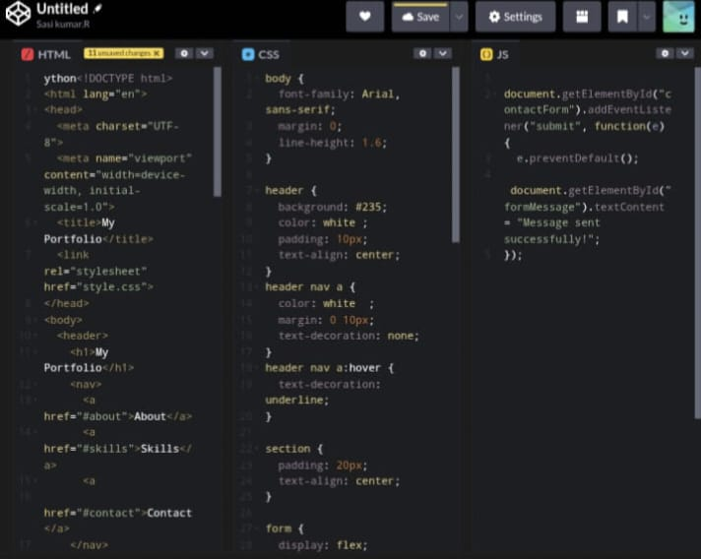
RESULTS AND SCREENSHOTS
Coding Screenshots
10

Slide 11
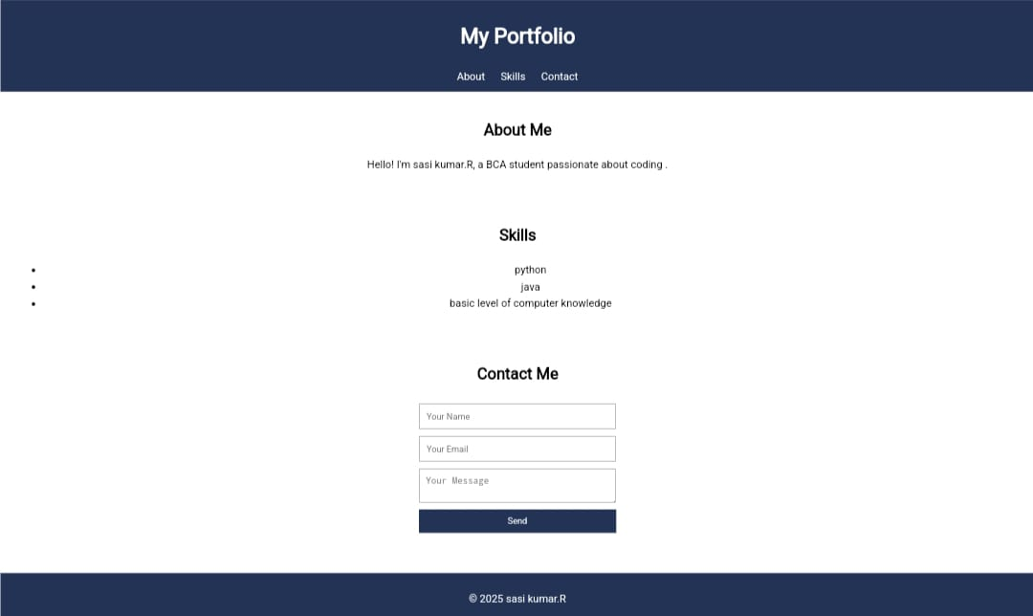
OUTPUT

Slide 12
CONCLUSION
Successfully created a personal portfolio website.
Helps in showcasing my skills and projects.
Useful for academic and professional growth
12

Slide 13
Github Link

